Slide 1
JSP
Lecture VIII

Slide 2
Java Server Pages (JSP) is a server-side programming technology that enables the creation of dynamic, platform-independent method for building Web-based applications.
JavaServer Pages (JSP) is a technology for developing Webpages that supports dynamic content. This helps developers insert java code in HTML pages by making use of special JSP tags, most of which start with <% and end with %>.

Slide 3
JSP Engines
The web server needs a JSP engine, i.e, a container to process JSP pages. The JSP container is responsible for intercepting requests for JSP pages.
A JSP container works with the Web server to provide the runtime environment and other services a JSP needs. It knows how to understand the special elements that are part of JSPs.

Slide 4
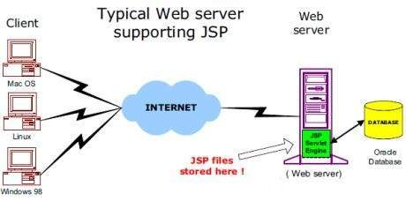
Following diagram shows the position of JSP container and JSP files in a Web application.

Slide 5
The following steps explain how the web server creates the Webpage using JSP −
As with a normal page, your browser sends an HTTP request to the web server.
The web server recognizes that the HTTP request is for a JSP page and forwards it to a JSP engine. This is done by using the URL or JSP page which ends with .jsp instead of .html.
The JSP engine loads the JSP page from disk and converts it into a servlet content. This conversion is very simple in which all template text is converted to println( ) statements and all JSP elements are converted to Java code. This code implements the corresponding dynamic behavior of the page.
The JSP engine compiles the servlet into an executable class and forwards the original request to a servlet engine.
A part of the web server called the servlet engine loads the Servlet class and executes it. During execution, the servlet produces an output in HTML format. The output is further passed on to the web server by the servlet engine inside an HTTP response.
The web server forwards the HTTP response to your browser in terms of static HTML content.
Finally, the web browser handles the dynamically-generated HTML page inside the HTTP response exactly as if it were a static page.

Slide 6
JSP Elements
JSP Declaration
A declaration tag is a piece of Java code for declaring variables, methods and classes. If we declare a variable or method inside declaration tag it means that the declaration is made inside the servlet class but outside the service method.
We can declare a static member, an instance variable (can declare a number or string) and methods inside the declaration tag.
Syntax of declaration tag:
<%! Dec var %>
Here Dec var is the method or a variable inside the declaration tag.

Slide 7
JSP Scriptlet
Scriptlet tag allows to write Java code into JSP file.
JSP container moves statements in _jspservice() method while generating servlet from jsp.
For each request of the client, service method of the JSP gets invoked hence the code inside the Scriptlet executes for every request.
A Scriptlet contains java code that is executed every time JSP is invoked.
Syntax of Scriptlet tag:
<% java code %>
Here <% %> tags are scriplets tag and within it, we can place java code.

Slide 8
JSP Expression
Expression tag evaluates the expression placed in it.
It accesses the data stored in stored application.
It allows create expressions like arithmetic and logical.
It produces scriptless JSP page.
Syntax:
<%= expression %>
Here the expression is the arithmetic or logical expression.

Slide 9
JSP Comments
Comments are the one when JSP container wants to ignore certain texts and statements.
When we want to hide certain content, then we can add that to the comments section.
Syntax:
This tags are used to comment in JSP and ignored by the JSP container.
<!—comment -->
This is HTML comment which is ignored by browser

